Slide 1
Intro to Metagenomics
Alan Twaddle
Full Stack Developer
Gunsalus/Piano Lab
January 18, 2017

Slide 2
Definitions
Metagenome:
The genetic information of a complex population that is constituted by the genomes of many individual organisms.
Microbiome:
The totality of microbes, their genetic information, and how they interact.
Microbiota:
The collection of microbial organisms from a defined environment.

Slide 3



What is Metagenomics?
The study of genetic material recovered directly from environmental samples
Notes:
Common environments are soil, sea water, and fecal matter.

Slide 4
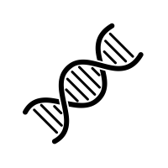
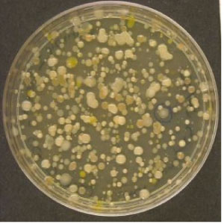
Why Metagenomics?
It makes ‘invisible’ organisms visible
Notes:
The old way to do things is to plate your sample, see if anything grows, isolate the culture, and sequence.
However, the vast majority of bacteria cannot be cultured this way

Slide 5
Cultured vs Uncultured Microorganisms
<1%
Biosphere has 10³⁰ -10³¹ microbial genomes
Notes:
5
Less than 1% of the total microbial diversity has been cultured. We know virtually nothing about the other 99% of the microbial world…

Slide 6
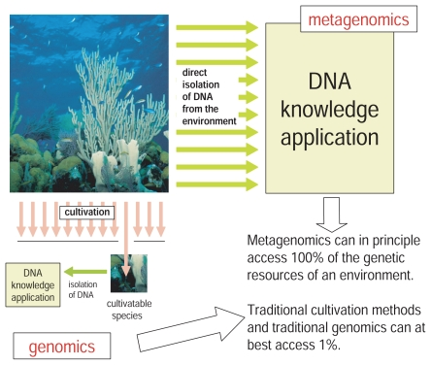
Notes:
This emphasizes the differences between traditional culturing methods and metagenomics.
In theory metagenomics can sequence 100% of your sample, whereas culturing can only sequence what you cultured.

Slide 7
Microbes are IMPORTANT!
Modulate and maintain the environment
Keep us healthy
Support plant growth and suppress plant disease
Clean up fuel leaks
Notes:
It is important to understand all the microbes within an environment since they play important roles in many aspects of life.

Slide 8
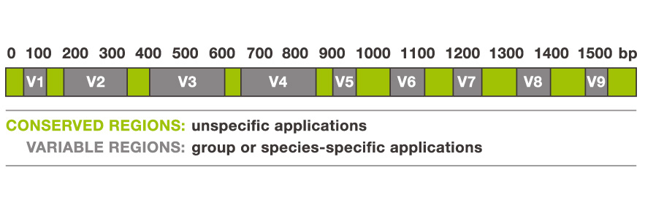
First Run at Metagenomics
Collect samples, isolate nucleic acid, PCR, clone, then sequence
Initially studied 16s rRNA sequences of bacteria
Notes:
The first run at metagenomics was aimed at the 16s rRNA gene since it is conserved throughout all bacteria and has hypervariable regions.
variable regions are not subject to the selective pressures that the conserved regions, making them good candidates for species identification.

Slide 9
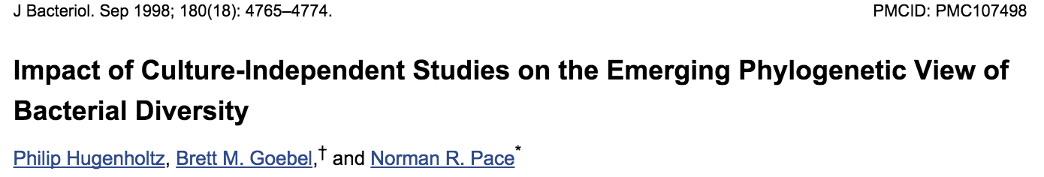
Unexpected Findings
Sequence analysis yielded many unknown 16s strains
Suggested that organisms overlooked by conventional methods
Notes:
A study that brought to light the hidden world of bacteria utilized the culture-independent sequencing method, targeting the 16s gene.
They also plated the samples and saw that the number of unique copies of 16s genes far exceeded the number of colonies plated, suggesting that traditional methods may be overlooking many organisms.

Slide 10
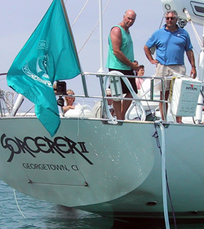
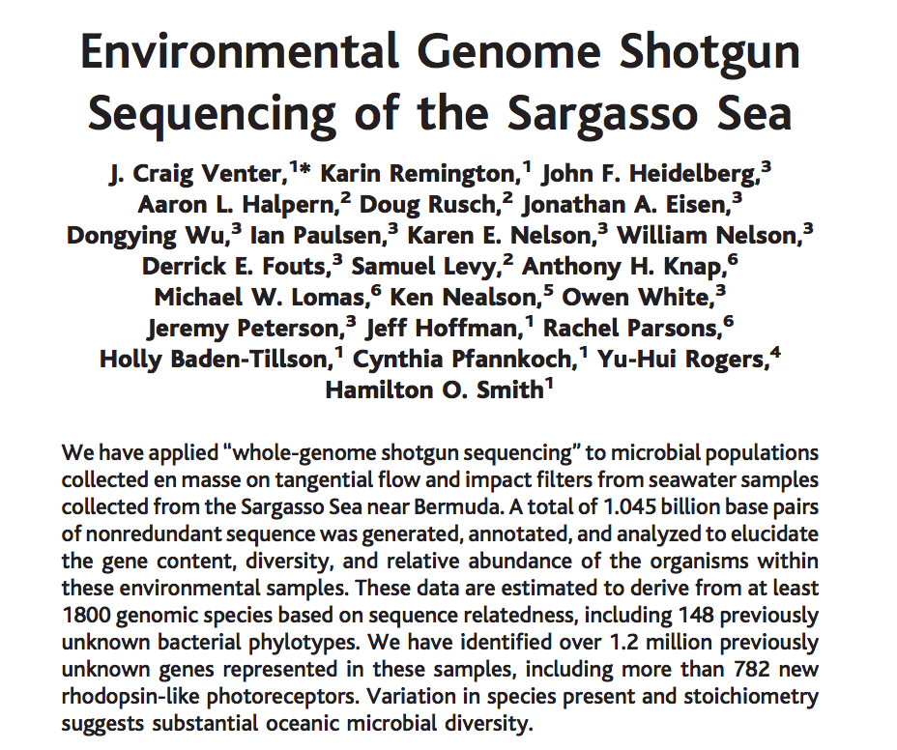
Notes:
J Craig Venter sailed around the Atlantic Ocean and collected different sea water samples. He used his shotgun sequencing method to directly sequence his samples

Slide 11
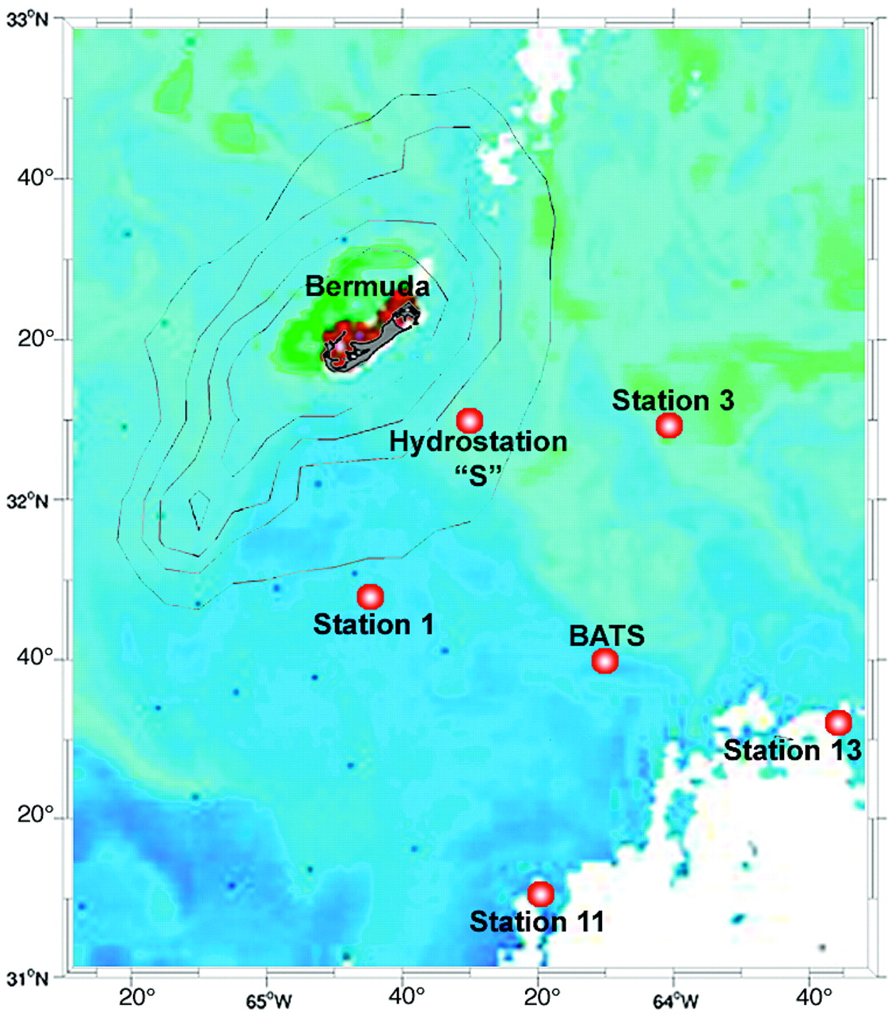
Collected samples from Sargasso Sea
Assembled sequences
Blasted contigs
Found ~2,000 different species
A large number being novel
Notes:
He found that there were many different species based on location and that many of them were novel.

Slide 12
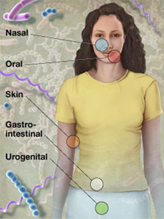
The Human Microbiome Project
Program to characterize microbial populations throughout the human body
Identify the “core” bacteria
Establish microbial profiles and correlate with human health and disease
Human Microbiome Project Data Analysis and Coordination Center
Notes:
The saragasso sea study catapulted the world of metagenomics. Since much progress has been made on the human genome, the next step would be to sequence the microbes found on and within the human.
In came the HMP

Slide 13
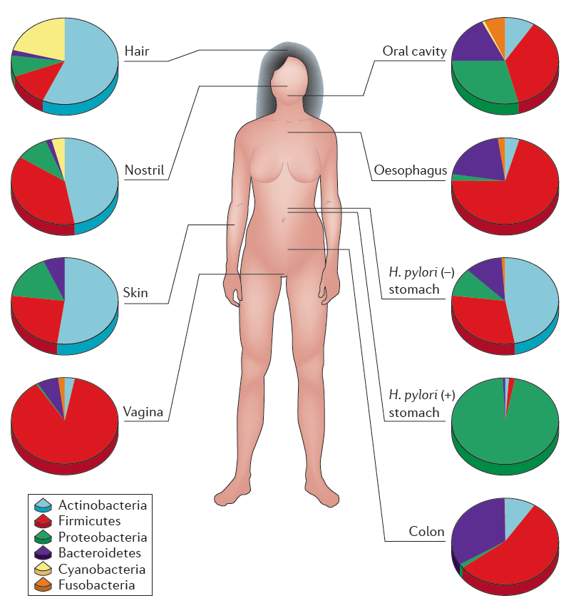
Cho & Blaser 2012 Nature Reviews Genetics 13:260
Notes:
It started by studying these areas on the human body that are part of the HMP.
You can see that there is substantial intra-individual microbe variation.
13

Slide 14
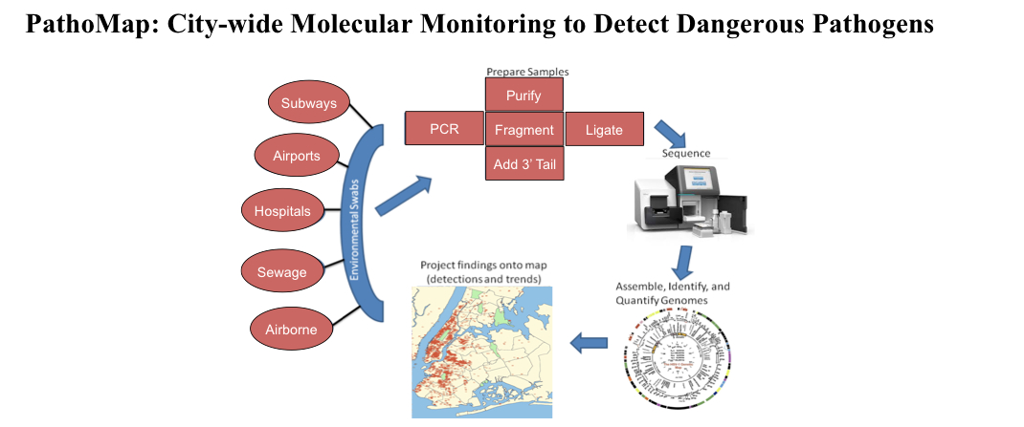
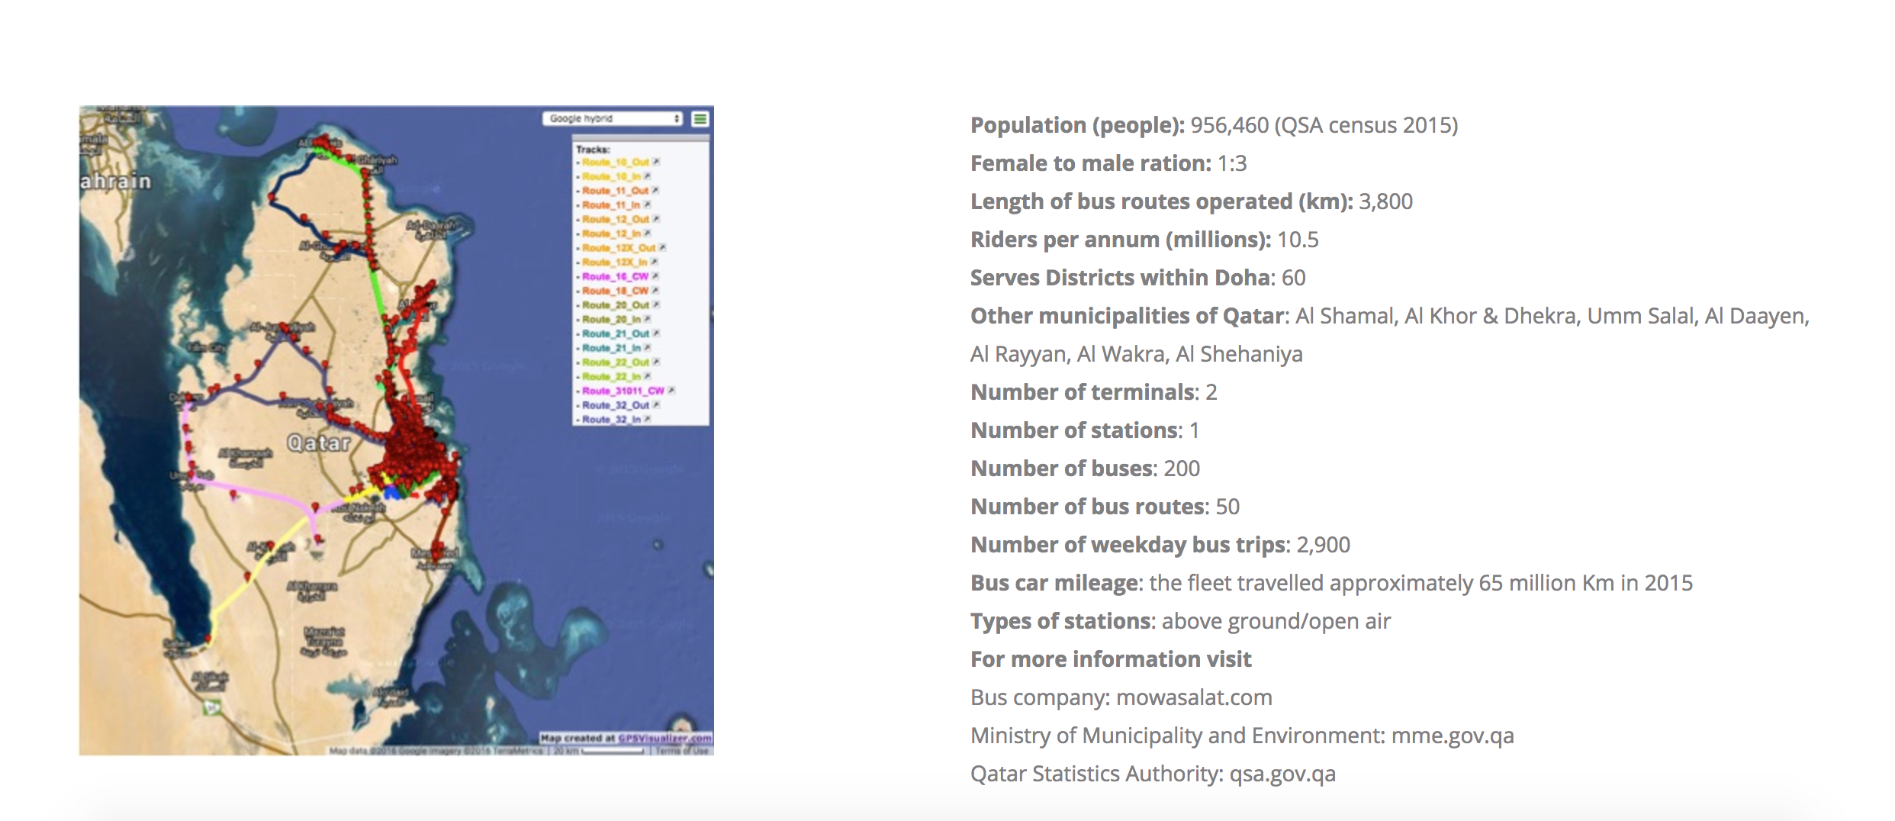
PathoMap (now MetaSub)
Notes:
However, the metagenomic studies do not stop at humans.
Pathomap originally started as a project by Cornell University to identify and survey pathogenic microbes within the New York City public areas, mainly the subway system. This later expanded to a global initiative. Doha is currently an area of interest for this project.

Slide 15
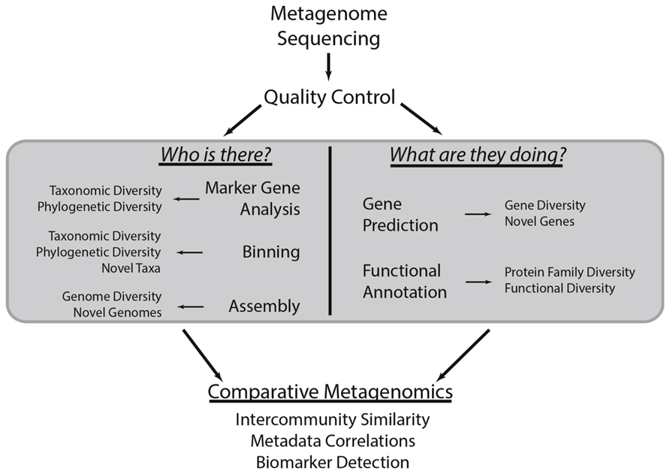
Notes:
In virtually ever metagenomics study there are two main questions that are asked: who’s there an what are they doing?
However, there are many different paths to get to these answers.

Slide 16
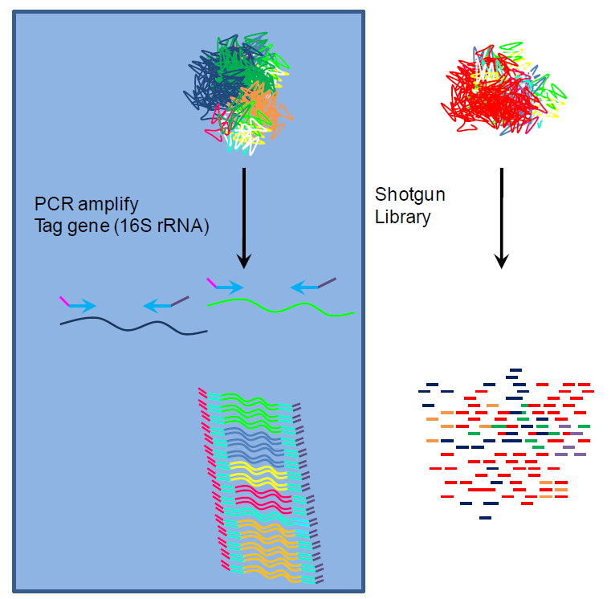
Targeted vs Shotgun Metagenomics
From http://cage.unl.edu/
Notes:
The two current methods of creating your libraries are target Target metagenomics and shotgun metagnomics.
Target metagenomics is targeting a specific region of a genome that is shared across multiple organisms and samples.
Shotgun metagenomics is a nondiscriminate way to sequence everything in your sample – perfect for all organisms.
16

Slide 17
Targeted vs Shotgun Metagenomics
Targeted
Shotgun
Pros
Great depth
More precise
Only sequence a specific region
16s rRNA
18s for fungi
ITS and entire operon add more info
Cons
Unequal amplification
Only looks at one part of one gene (for rRNA/ITS sequencing)
Not enough resolution for species/subspecies identification
OTUs instead
Impossible to directly assess microbe’s function
Pros
Can theoretically sequence 100% of sample
Greater resolution to genetic content
Can assess function
Identify novel organisms/genes/genomic features
Cons
Rarely sequence everything in sample
Not as much depth
Will sequence host/contaminant DNA
Very complex dataset
$$$$
Notes:
Each method has its own pros and cons.
targeted:
Pros:
Great depth – you sequence hundreds of copies of a specific region
Will sequence only this region, assuming your primers work
Cons:
Due to many factors, certain targeted regions will be amplified at different rates
Since you’re only sequencing one small part of an organism’s you do not know what other genes its genome contains
Shotgun
Pros
Sequencing more genes and more of the genome, so you can infer a lot
Cons:
Rarely comes close to sequencing everything in the sample.
More horizontal coverage than vertical
It’s more expensive than targeted sequencing

Slide 18
targeted metagenomics

Slide 19
Targeted Metagenomic Analyses
~1,000,000 Sequences
Sort by barcode
Alignment/Clustering
Quantitative Analysis
of OTUs
Statistics
Diversity Estimates
Rarefaction
curves
Chao
(Confidence Intervals)
OTU= Operational Taxonomic Units
Notes:
General workflow for 16s analysis. I’ll be talking about the 16s analysis since it is the most prominent targeted analysis.
It is somewhat limited since it is only a very small ~500bp segment of an organism’s genome.

Slide 20
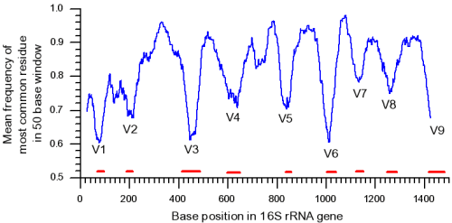

16s for Taxonomic Assignment
Most widely used marker gene for bacteria
Has both highly conserved regions and highly variable regions
16s rRNA
Notes:
20
The peaks represent conservation, the valleys represent variability.
Variation is generally greater across species than within, making species identification much easier
Similar profile to 18s gene for fungus

Slide 21
Multiple Sequence Alignment
Sample 1
Sample 2
First step is to align all of your sequences together per sample
Notes:
The first step is to align all your sequences using multiple sequence alignment.
Since the structure of the 16s operon is highly conserved, aligning you reads to a reference is safe and efficient, but you can do this reference free as well.
This figure represents two aligned 16s samples. Note the variation in the proportions of colors. This represents the diversity of 16s genes, though we do not know the actual abundance of each color going into the analysis.

Slide 22
Clustering OTU’s
= 1 OTU
Each sequence has a neighbor
with at least 97% relatedness
(Nearest Neighbor)
or
= 2 OTUs
An operational taxonomic unit (OTU) is an operational definition used to classify groups of closely related individuals.
All sequences within a cluster
have at least 97% relatedness
(Furthest Neighbor)
Reproduced from Hamady & Knight 2009
Notes:
The next step is to cluster your aligned sequences into OTUs.
OTU stands for operational taxonomic unit. An operational taxonomic unit (OTU) is an operational definition used to classify groups of closely related individuals.
Since the resolution of 16s sequencing isn’t great enough to identify species, we use OTUs as a placeholder.
Clustering is done by giving a similarity threshold. In most cases, OTUs are composed of sequences that are 95-99% identical.
There are many different clustering algorithms but will all create an OTU.
Two common algorithms are nearest neighbor and furthest neighbor.
Nearest means all sequences in a cluster are 97% identical to each other, whereas furthest means all sequences are 97% identical to a specific sequence.
Deciding on which clustering algorithm to use is very difficult so I’m not going to get into it.

Slide 23
Clustering OTU’s
Sample 1
Sample 2
OTU1
OTU1
OTU2
OTU2
OTU3
OTU3
OTU4
Pick a representative sequence from each OTU.
Working with entire alignments is painful, though possible.
Notes:
Once clustering is done you now have groups of sequences that are within your similarity threshold.
However, each OTU is multiple sequences. It is common practice to choose one sequence in each cluster to use a representative for downstream analysis. This makes things more efficient and easier.
These are considered your metagenomic profiles

Slide 24
Taxonomic Assignments of OTUs
Select representative
of each OTU
Compare to
databases
OTU1
Firmicute; Bacillus
OTU2
Firmicute; Anaerococcus
OTU3
Bacteroidetes; Prevotella
OTU4
No assignment
[Phylum; Genus]
Alignment of sequences to SILVA, RDP, greengenes, etc.
Use this information to create trees and other graphics
Notes:
As I mentioned earlier, when going forward it is very useful to reduce the size of the dataset. Since everything within an OTU is similar, picking a representative is trivial.
Once you pick your OTU representative you can query that against a database to assign taxonomy.

Slide 25
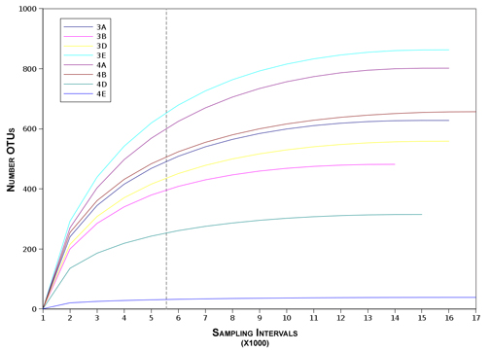
Rarefaction curves to determine if sequencing is exhaustive
Highest
diversity
Lowest
diversity
Notes:
A common graph used in metagenomics is a rarefaction curve.
To see how well you sequenced your sample, you can use this to show the number of OTUs determined in each sample for a set number of sequence reads. The dashed line indicates the number of OTUs we see with only 5,500 reads.
The ideal scenario is high number of OTUs at a low sampling intervals.
This is a good way to see if you should have sampled enough
25

Slide 26
Analyses
Alpha-diversity vs beta-diversity
How many taxa within a sample vs how many are shared across samples
Community membership vs community structure
Relative abundance vs Presence-absence
Phylogenetic vs taxon-based
Evolutionary relatedness of sequences vs all taxa phylogenetically equivalent
Notes:
Once you’ve established your profiles you can go forward with comparing samples.
There are several comparisons that are generally used
Community membership is assigning a fingerprint to your OTU whereas structure is looking at the proportions within that fingerprint
phylogenetic based is looking at how related these organisms are and taxon based is looking at what kinds of bacteria are there

Slide 27
Alpha Diversity
Sample 1
Sample 2
OTU1
OTU1
OTU2
OTU2
OTU3
OTU3
OTU4
Alpha diversity, i.e. how many taxa in a sample.
Establishing profiles.
Notes:
Going back to our original example, this is an example of alpha diversity

Slide 28
Beta Diversity
Sample 1
Sample 2
OTU1
OTU1
OTU2
OTU2
OTU3
OTU3
OTU4
Beta-diversity, i.e. how many taxa shared across samples
Comparing profiles.
Notes:
And this is beta diversity – look at the difference in presence absence/abundance of OTUs

Slide 29
Community Structure
Sample 1
Sample 2
OTU1
OTU1
OTU2
OTU2
OTU3
OTU3
OTU4
Relative Abundance: Proportion of taxa within a sample
Notes:
Community structure looks at the proportions of taxa compared to the rest

Slide 30
Community Membership
Sample 1
Sample 2
OTU1
OTU1
OTU2
OTU2
OTU3
OTU3
OTU4
Community Membership: Assigning a taxonomic fingerprint
Notes:
Community membership identifies only the organisms that are there

Slide 31
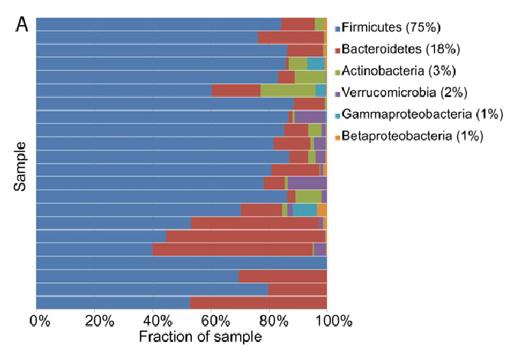
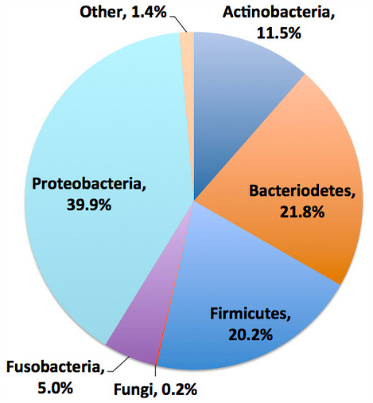
Output is Typically a Pie Chart or Graph with Assignment
[Phylum level]
Trees can be useful but not always the most informative
Notes:
In making these comparisons, these graphs are normally the end result.
The top graph is looking at the relative abundance of each organism within a sample across all samples
The bottom is looking at the proportions within a sample
These the typical end result for 16s analysis

Slide 32
QIIME
Pronounced “chime”
Quantitative Insights Into Microbial Ecology
Modular pipeline for the analysis if both targeted and shotgun data
Shotgun analysis still considered “beta”
Notes:
QIIME is an environment that is built on ubuntu.

Slide 33
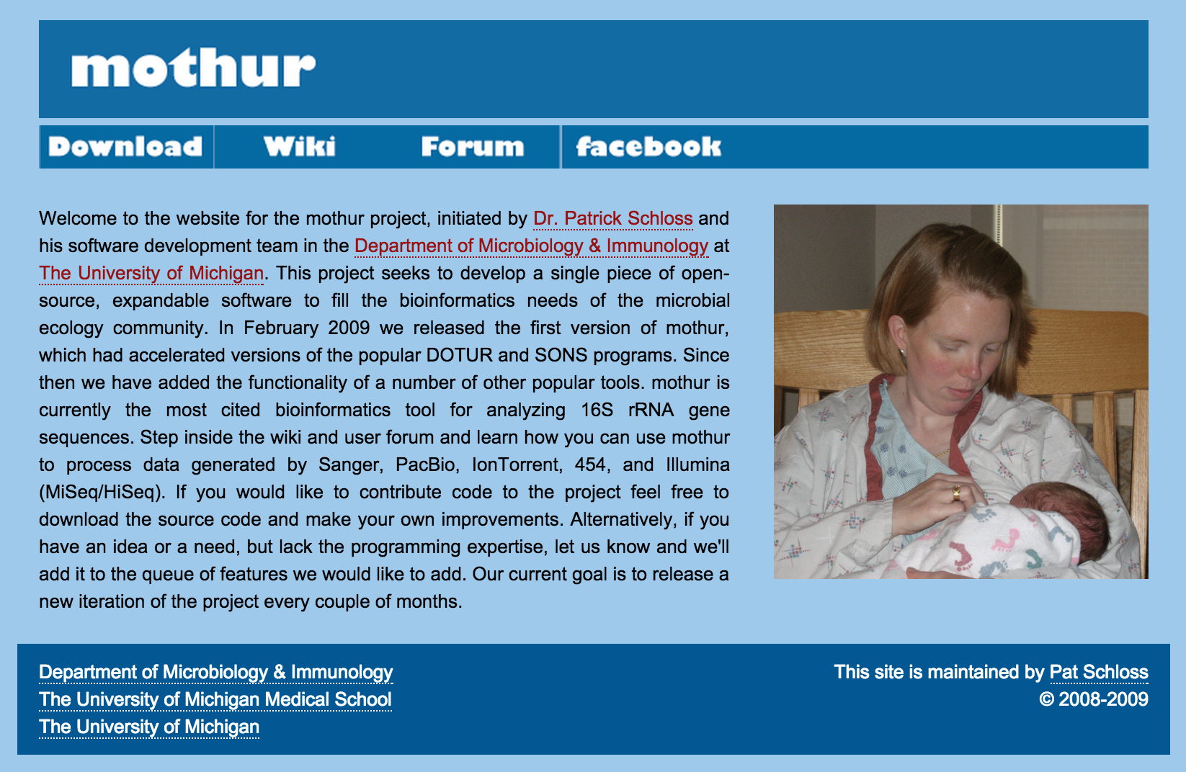
Mothur
Notes:
Similar to QIIME though.
Both of these are environments but can be used modularly

Slide 34
SILVA
A comprehensive online resource for quality checked and aligned ribosomal RNA sequence data.
Used for supervised clustering to determine OTUs.
Notes:
These databases are useful when clustering – you can align your sequences to these databases to quickly establish taxonomy as opposed to doing de novo OTU picking, though it still may be necessary.

Slide 35
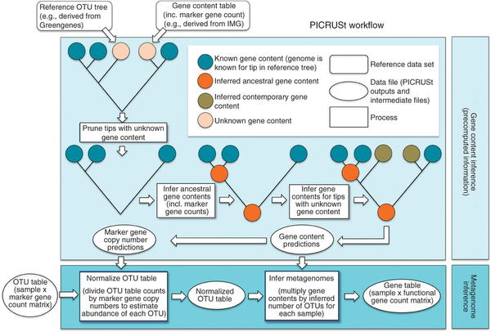
PICRUST
Uses 16s to predict functional capacity using associated genes and gene families
Notes:
Based on the taxa that you assigned to your OTUs, PICRUST can use that assigning your the taxa’s gene content.

Slide 36
Shotgun metagenomics

Slide 37

BUT First let me filter my data

Slide 38
Quality Control
The key to shotgun metagenomics is clean data
What’s there that shouldn’t be there?
Human, rRNA, PhiX
Remove uninformative reads
Low quality
Low complexity
Artifacts
Adapters

Slide 39

No Filtering
Analysis
Notes:
So you can do your analysis without filtering, and you can get some usable results, though they may not be very informative or accurate.

Slide 40

With Filtering
Analysis
Notes:
If you filter you are guaranteed to have the highest quality data going into your analysis.

Slide 41
Before You Start
Contaminant removal can take a very long time
Consider clustering your reads to reduce query size
Extremely useful for metatranscriptome data
rRNA reads are very prominent when sequencing RNA from a host
CD-HIT
UCLUST
Reinflate clusters prior to any quantification!
Make sure you cluster on 100% identity
Notes:
Just like picking a representative of your OTUs for targeted sequencing, you reduce your data to a representative of a set of reads and use that for analysis.
Reinflate reads afterward to preserve proportions.

Slide 42
Quality Filtering and Trimming
Should be first step!
What your data look like
Will reduce data size, making subsequent steps faster
Removes:
Low quality bases
Low complexity sequences
Adaptor sequences
Notes:
What your data look like – the distribution of quality scores, adaptor sequences, artifacts.
This is important since when you’re querying kmers of 15bp you are more subject to false positives. Also, as you’ve already heard, low quality data really plays bad with assemblies

Slide 43
PrinSeq
Two step process:
Interrogate data and generate quality statistics (optional but recommended)
Trim, filter, mask, dust
Notes:
Prinseq is a common tool for understanding your data. It creates plots that describe your data and then will allow you to trim it

Slide 44
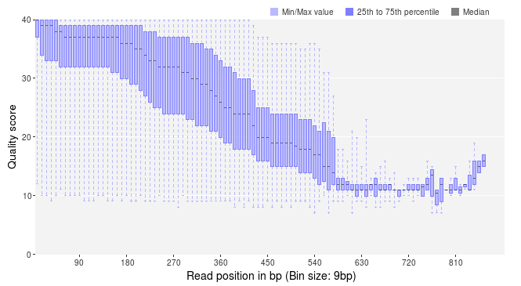
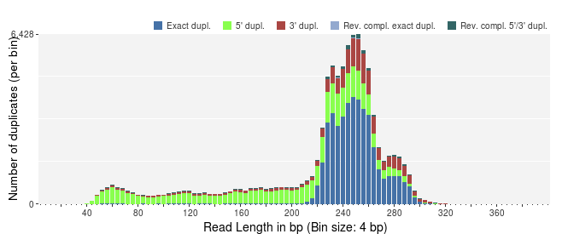
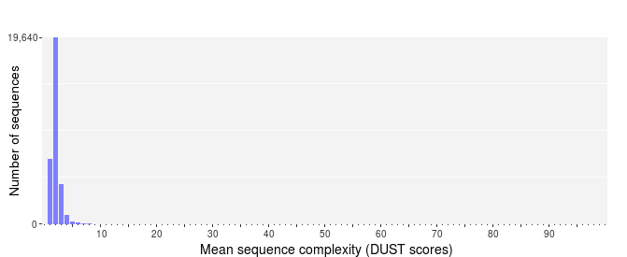
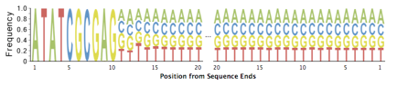
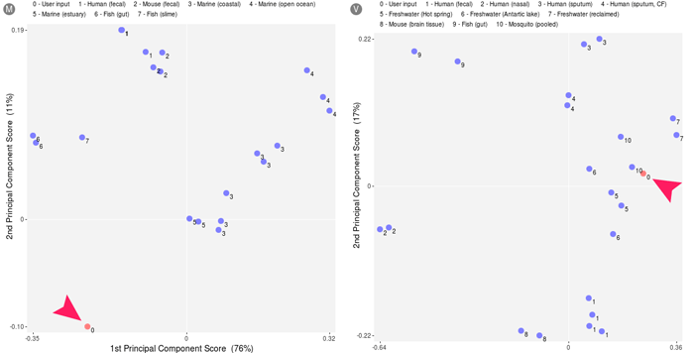
Notes:
Top left: Quality per score across all reads
Middle left: Mean complexity score
Top right: number of duplicate reads
Middle right: sequence logo describing the base distribution per position
Bottom right: PCoA analysis comparing your metagenomes to profiles of other metagenomes

Slide 45
Remove Contaminants
Should always remove PhiX!
This is in almost every Illumina sample
Remove host sequences
Interrogate for possible lab contaminants
For metatranscriptome/RNA data, remove rRNA
Notes:
PhiX is a phage whose DNA is added into low complexity libraries prior to sequencing to prevent the Illumina sequencer from bombing out. Even though these are not indexed, there is always some cross contamination into you data that will be identified by some algorithms that we will get into.
If you’re sequencing the human gut, you’re going to get some human DNA which you’re generally not interested in and can account for a large part of your data. The yield for usable reads from human samples is ~30-50%
Talk about bat herpes in virome sample
rRNA can account for 70% of your data in metatranscriptomes

Slide 46
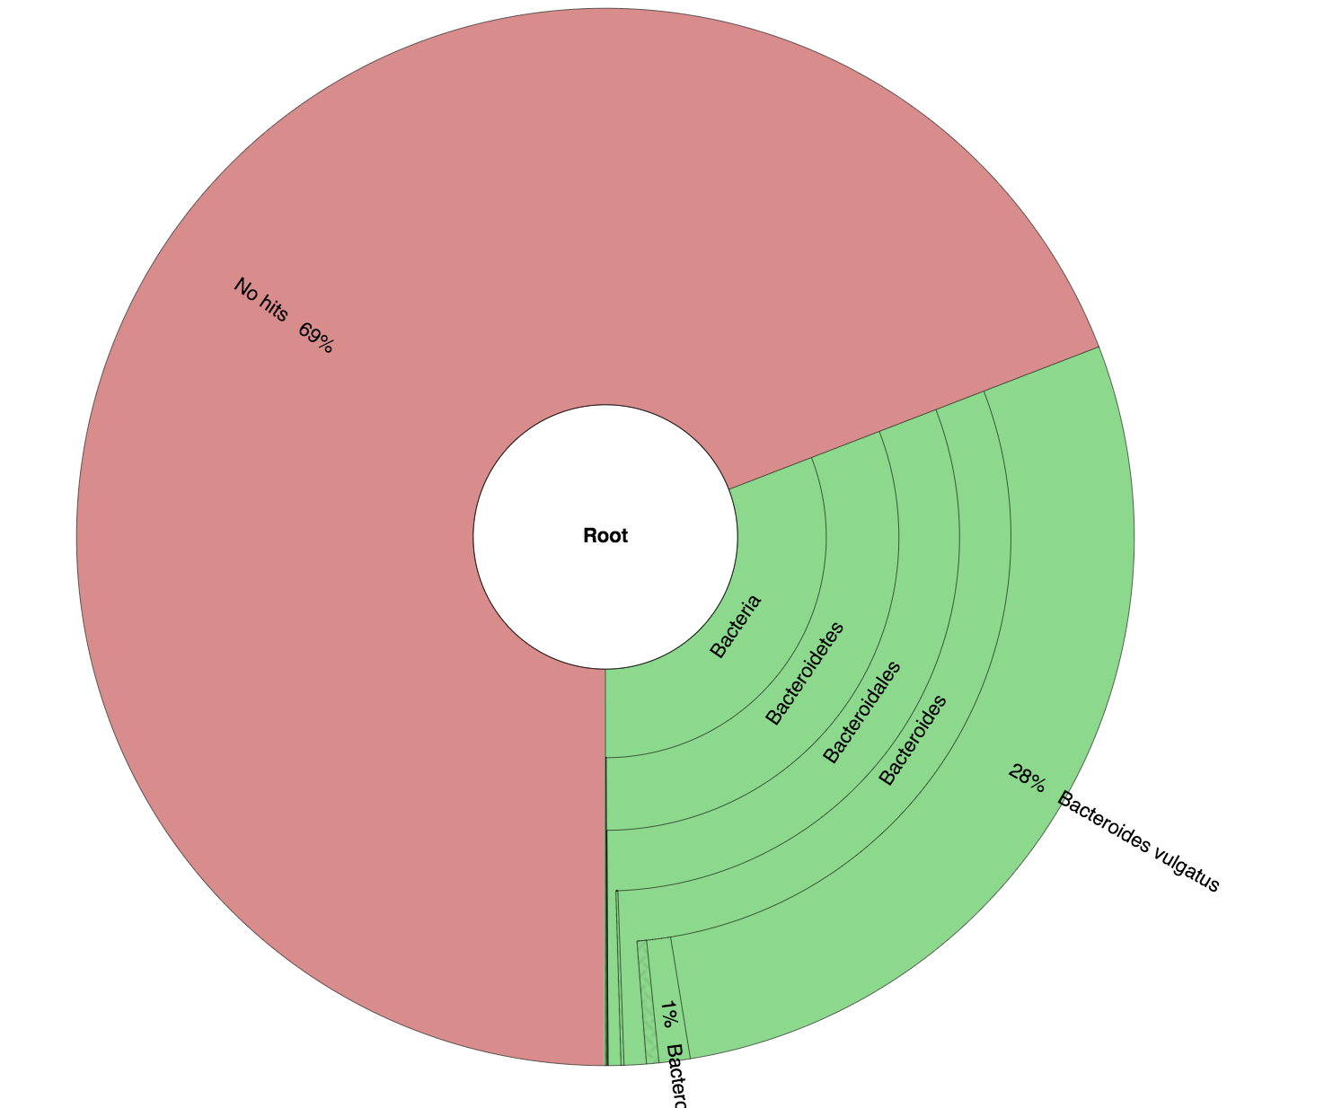
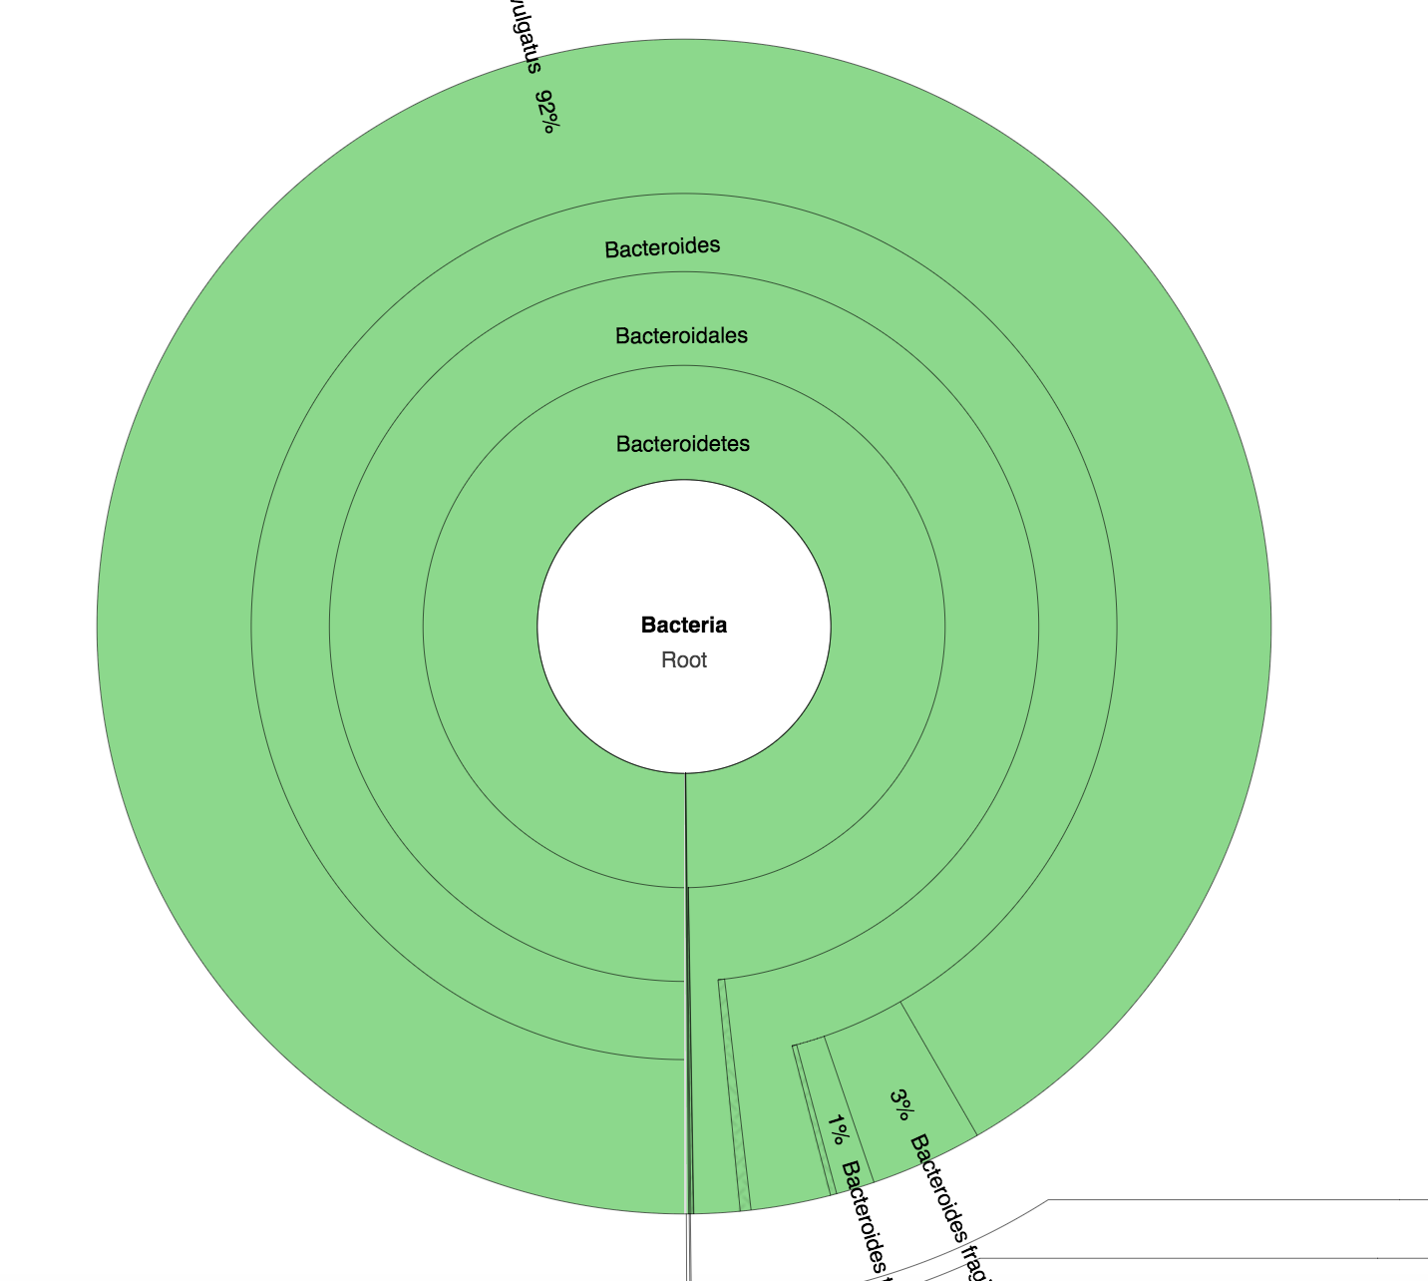
Before and After Contaminant Removal

Slide 47
Tools Available
Knead Data
Wrapper around bowtie2 and Trimmomatic that trims and filters your
RiboPicker
Removes rRNA data from metatranscriptomic data
DeconSeq
Removes sequences that match a user provided sequence database
Trimmomatic
Removes low quality data and adaptor sequences

Slide 48
shotgun metagenomics

Slide 49
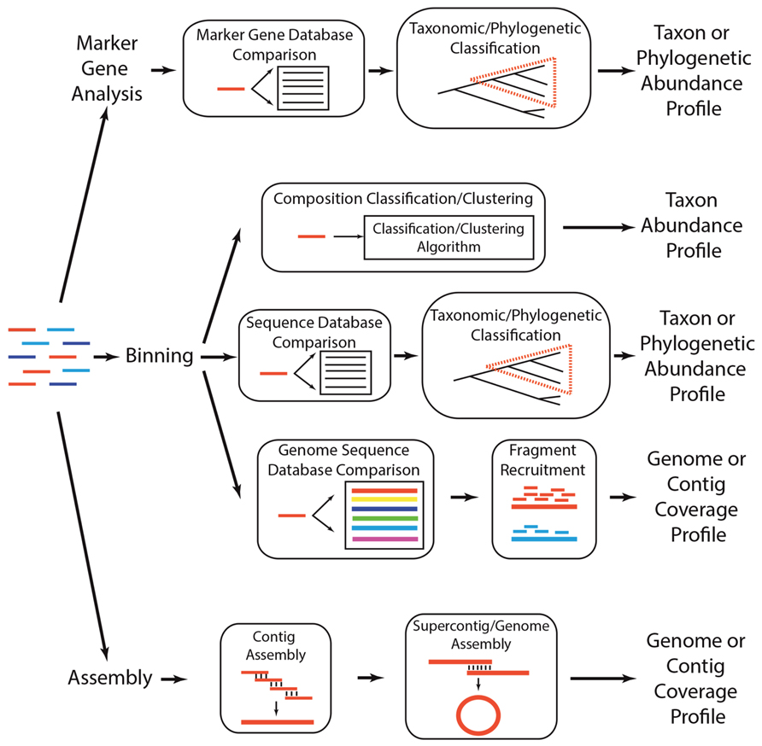
Shotgun Metagenomic Analysis Overview
T. Sharpton Frontiers in Plant Science 2014
Notes:
There are three main approaches when dealing with true metagenomic datasets.
Marker gene: queries for a certain set of sequences.
Binning: clusters sequences into similar groups, forming OTU-like entities
assembly: Try to put everything together in your sample

Slide 50
Binning
T. Sharpton Frontiers in Plant Science 2014
Notes:
We will start with the binning section, as some tools later on will rely on some of this methodology.

Slide 51
Kraken
Assigns taxonomic labels to short DNA sequences using a clade-specific kmer database
Built in databases RefSeq:
Human, Bacteria, Viruses, Plasmids
Can add custom sequences
Working on fungal database integration

Slide 52
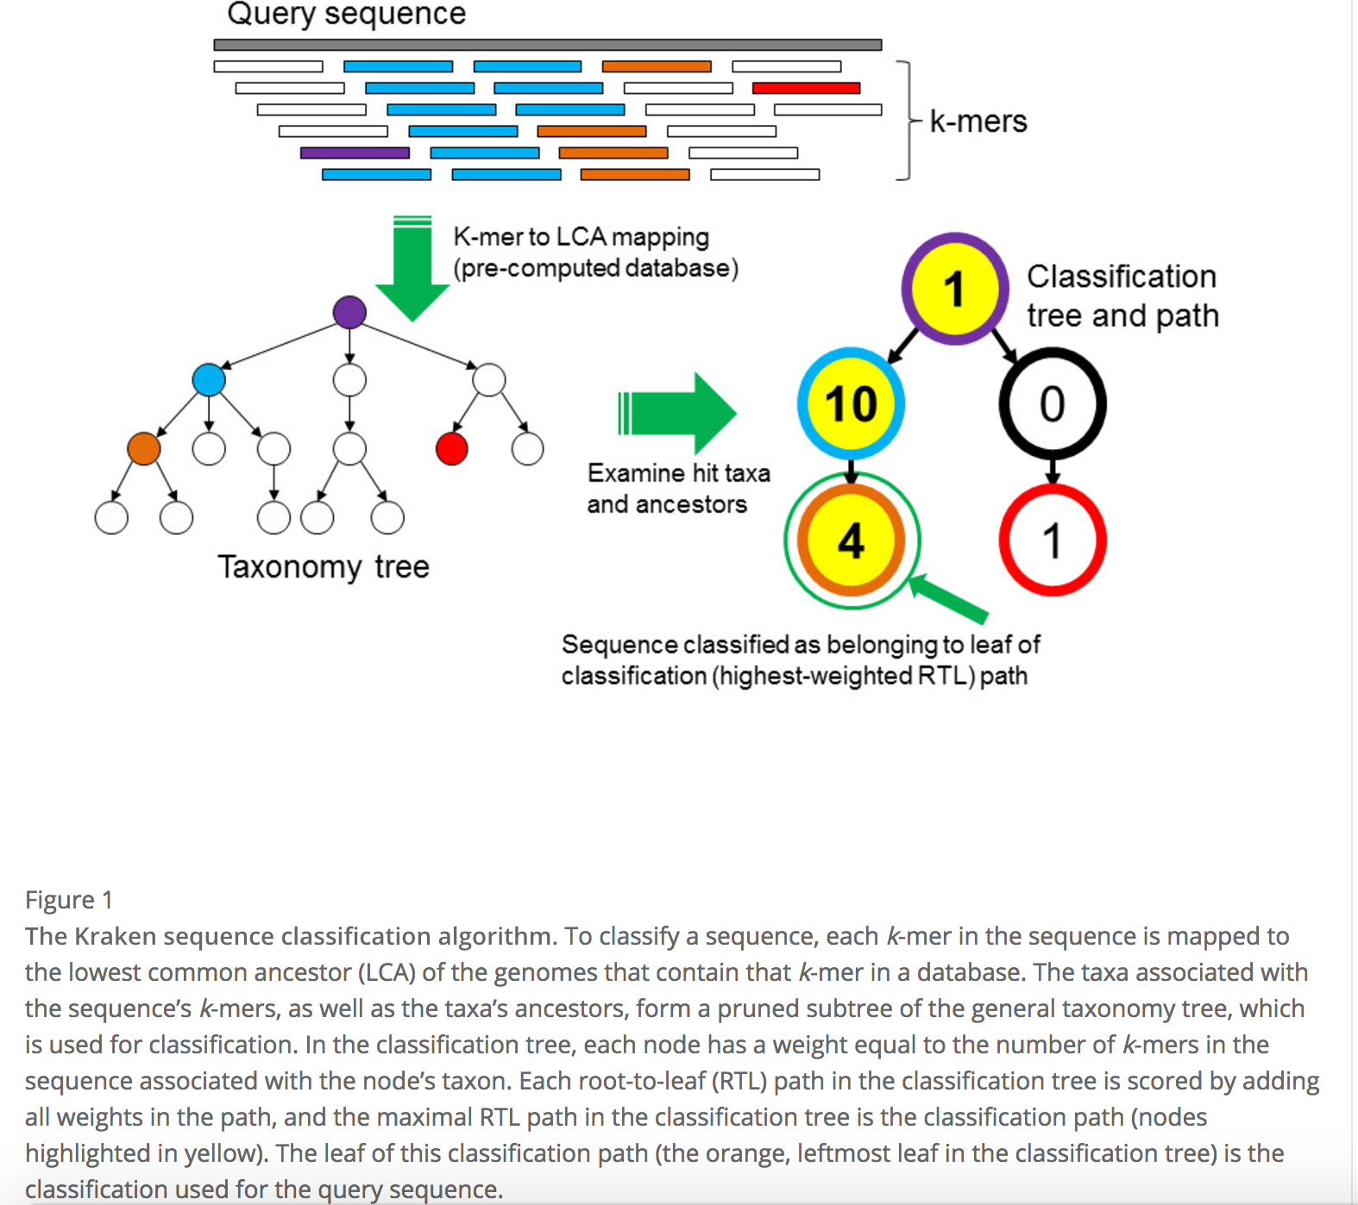
Notes:
Each sequence in the database is reduced into a set of unique kmers that are specific to a certain clade.
Each colored kmer is unique to a specific clade.
When querying your reads, it looks for these unique kmers within your reads and traverses the taxonomy tree as far as it can go.
The taxonomy is assigned to the path with the largest weight

Slide 53
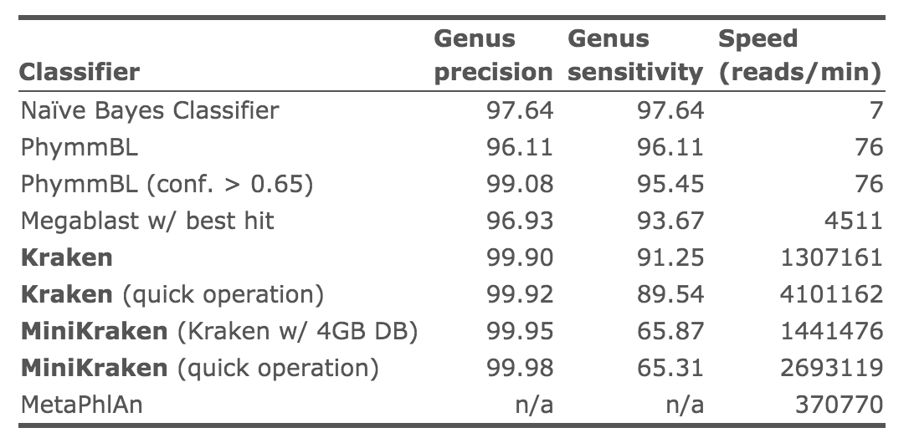
Kraken

Slide 54
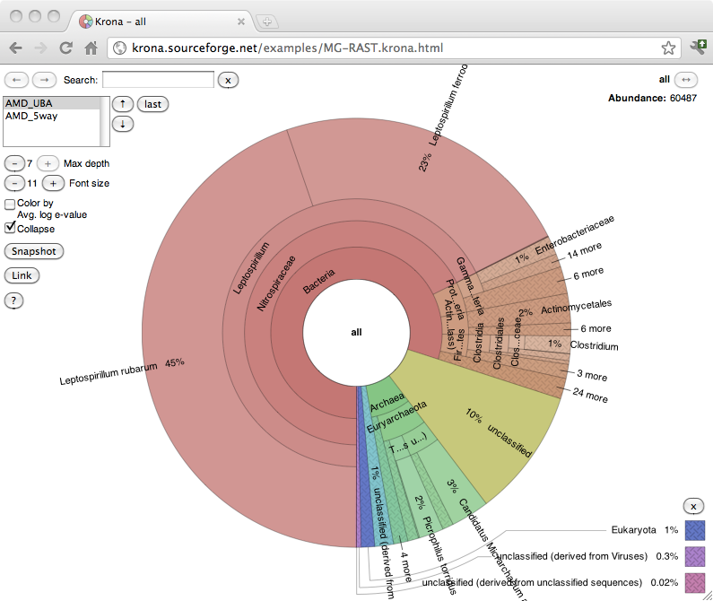
Krona for Kraken Visualization
https://github.com/marbl/Krona/wiki
Notes:
The output for Kraken is a list of taxonomy IDs and their counts. You can display this by using Krona which is an interactive HTML.

Slide 55
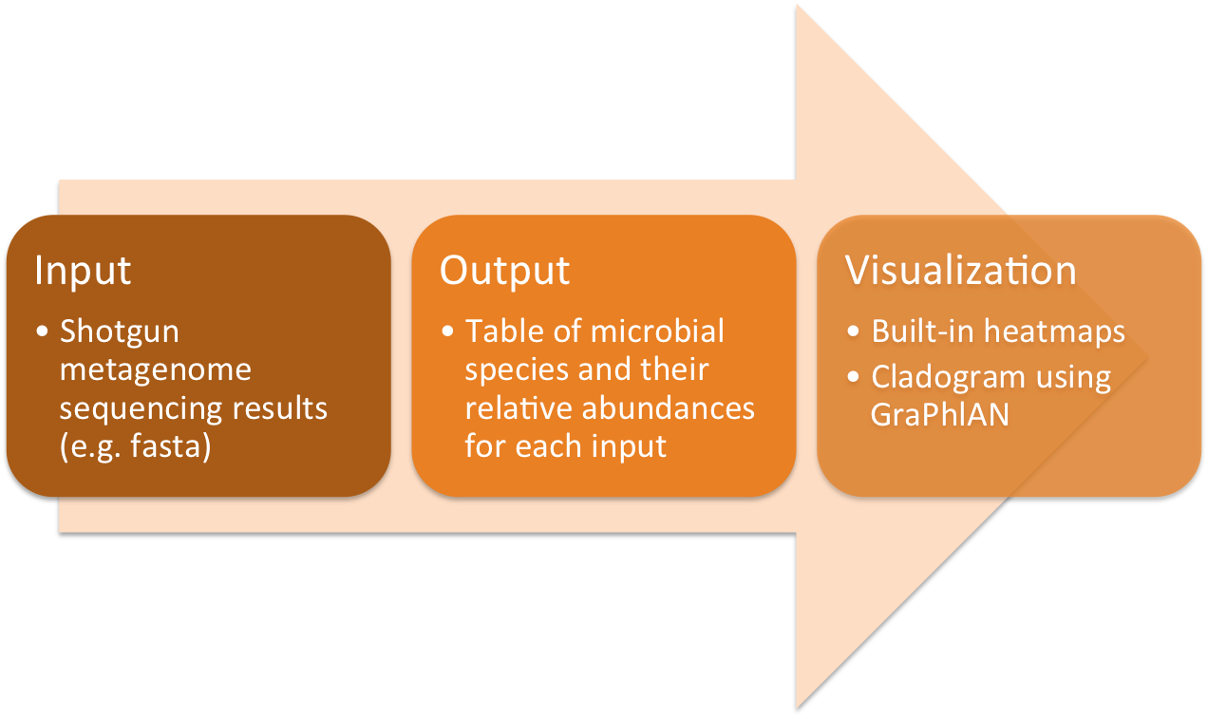
MetaPhlAn2
Taxonomic classification based on clade-specific marker genes
Similar to Kraken but not as good.
Notes:
Metaphlan queries a database that is very similar to the design of Kraken’s database.

Slide 56
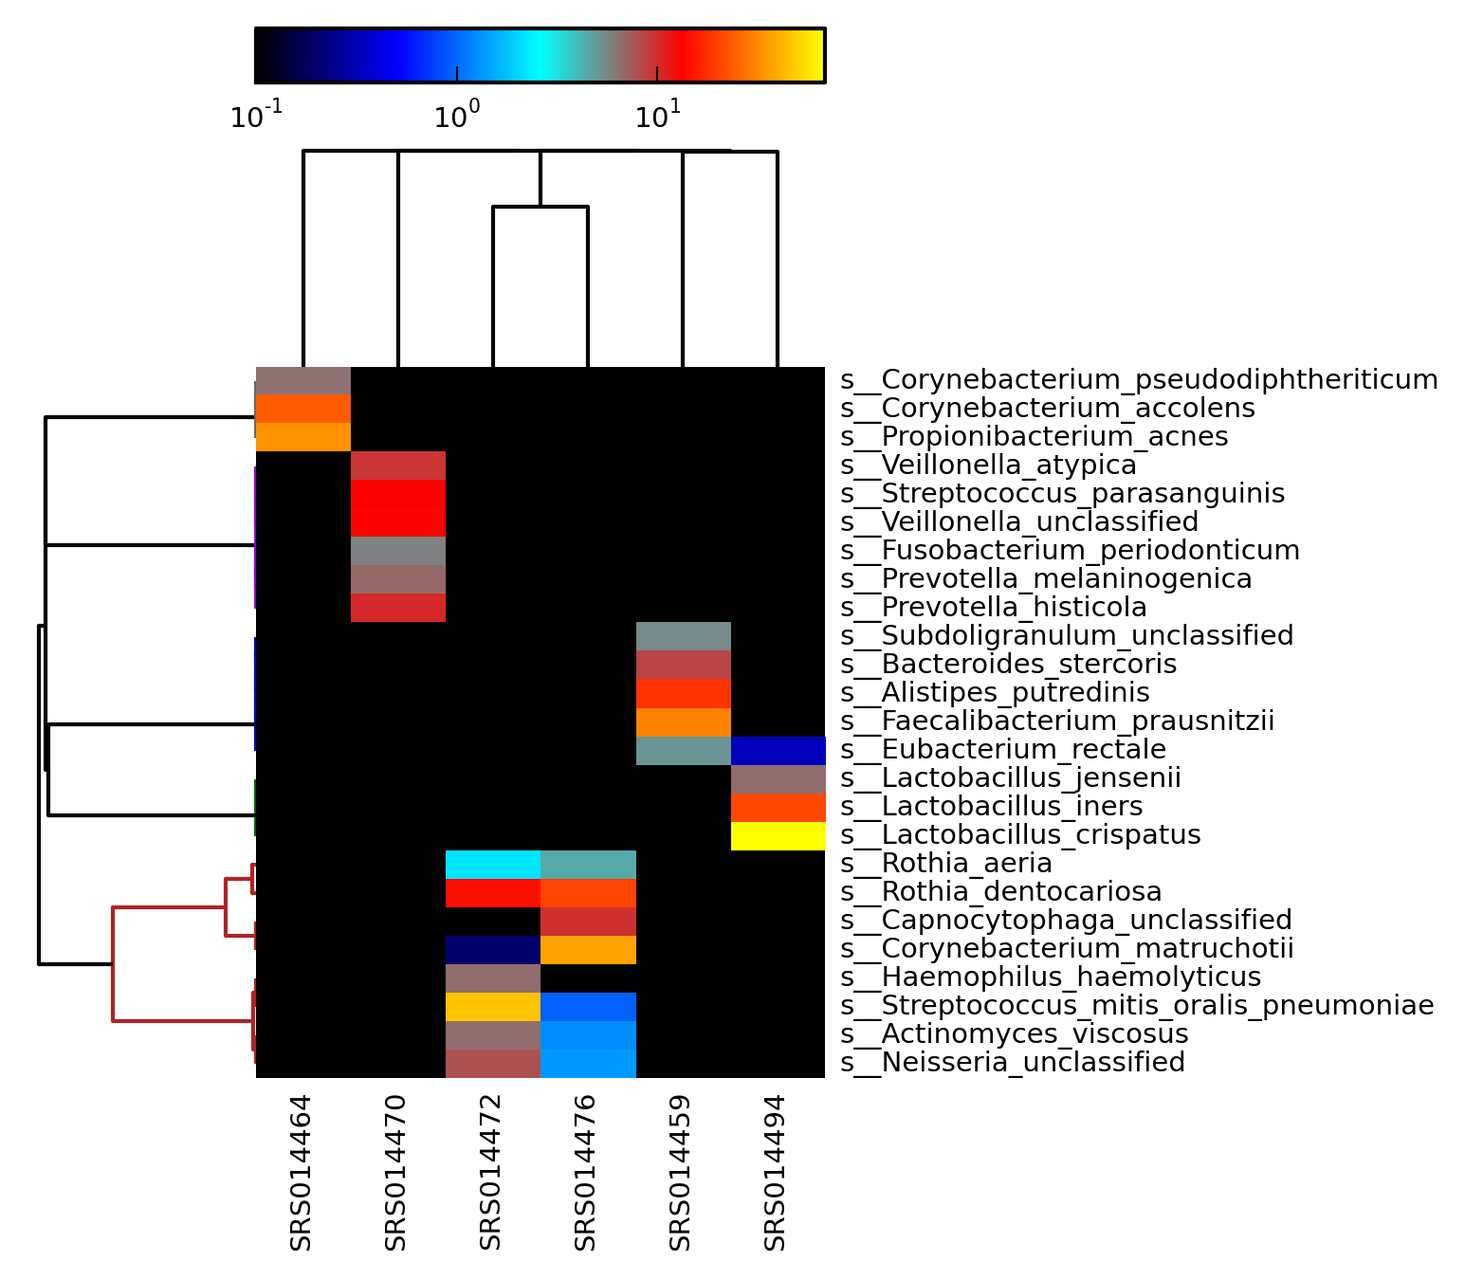
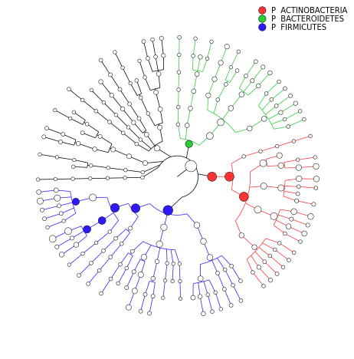
Visualization of MetaPhlAn
Notes:
Heatmap represents abundance of organisms per sample. Cladogram shows phylogeny and size of circles represent abundance of each clade within sample

Slide 57
Marker Gene Analysis
T. Sharpton Frontiers in Plant Science 2014
Notes:
Usually starts with a database of known sequences.
Classifies sequences using sequences in database and assigns metadata the reads.

Slide 58
MEGAN6
Visually represent phylogeny and taxonomy via targeted gene query
Takes in BLASTX input, but can run DIAMOND
Notes:
A bit clunky but very powerful and interactive.
Just released version 6 so I’m not familiar with what all it has to offer

Slide 59
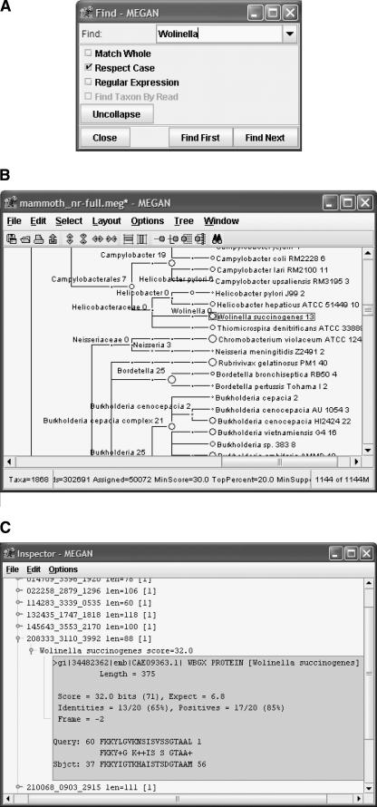
Notes:
Interactive graphical interface that allows you peruse cladograms and compare metagenomic profiles.

Slide 60
Humann2
HMP Unified Metabolic Analysis Network
Uses MetaPhlAn2
Functional community profiling using genome, genes, and pathways
Archaea, Bacteria, Eukaryotes, Viruses

Slide 61
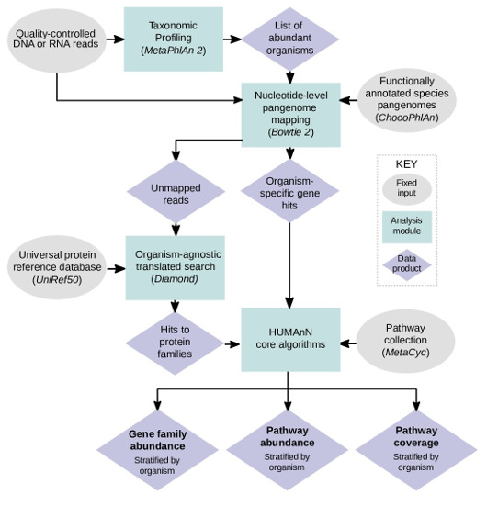
Humann2
https://bitbucket.org/biobakery/humann2
Notes:
Uses bowtie2 to query a “pangenome” to assign taxonomy, then uses diamond to infer function from translated protein searches and uses that information for pathway analysis.
Produces gene family and pathway abundance as well as pathway coverage (how much of the pathway is found in your sample)

Slide 62
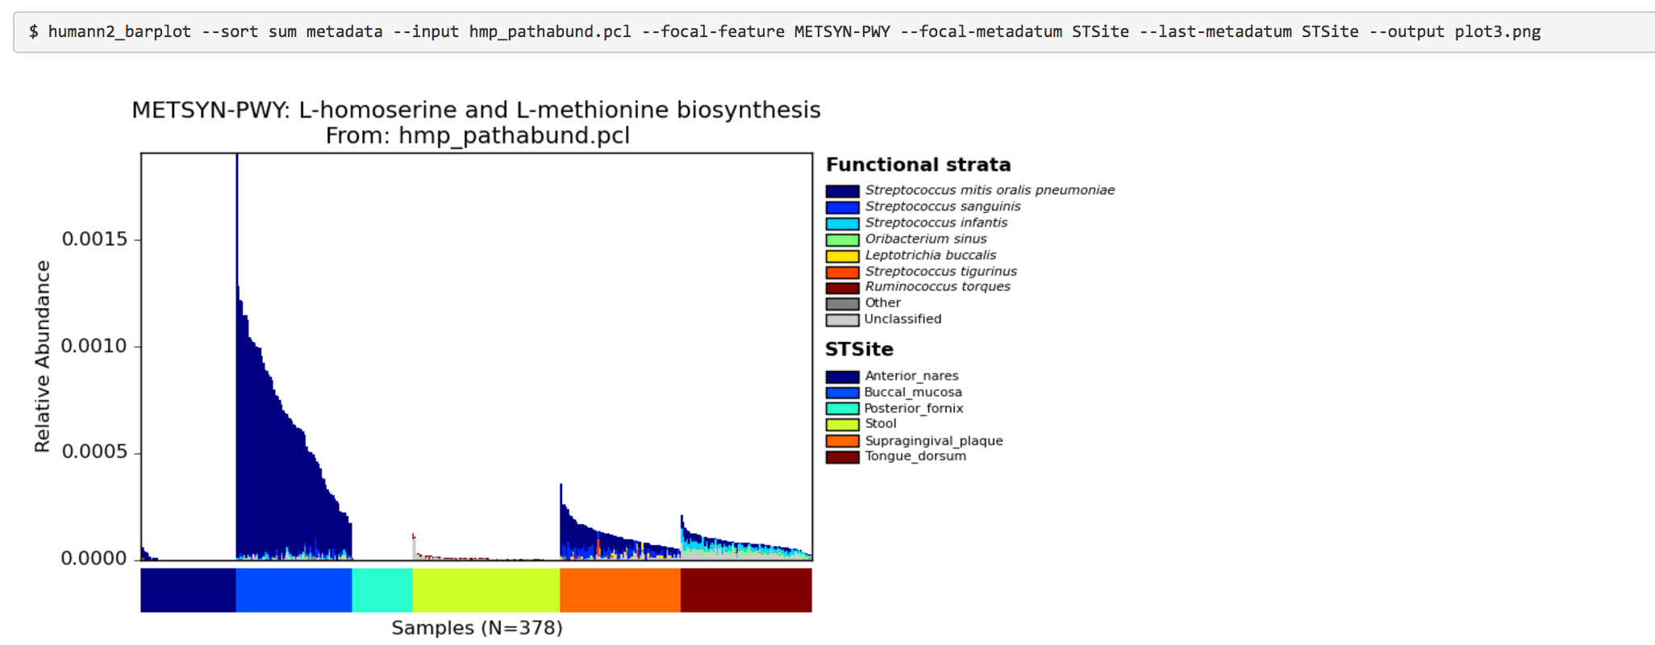
Notes:
This allows you to look at a specific pathway and separate it out by your sample label and looks at the organisms contributing to the pathways.

Slide 63
Assembly. The Holy Grail
T. Sharpton Frontiers in Plant Science 2014

Slide 64
Goals of Metagenomic Assembly
Construct as many and as much of the sequenced genomes as possible
Annotate for gene content
Assign taxonomy and function

Slide 65
Questions To Ask Before Starting
Are there organisms we know are present?
Are there organisms we are interested in?
Are the data clean?
Always worth a shot to try assembling off the bat

Slide 66
Reduce Complexity of Dataset
Filter
Clean
Subset

Slide 67
Identify Usual Suspects
Kraken (or kraken like analysis) should be done prior
If known organisms or prominent species are identified, supplement your assembly with reference data!
Notes:
Kraken is quick enough that when you get to your analysis you should have some preliminary results to work with

Slide 68
The Khmer Package
A toolkit for doing kmer-based data analysis and transformations
Extremely useful, especially for very complex and/or very large metagenomes

Slide 69
Features of the Khmer Package
normalizing read coverage ("digital normalization")
dividing reads into disjoint sets that do not connect ("partitioning")
eliminating reads that will not be used by a de Bruijn graph assembler
removing reads with low- and/or high-abundance k-mers
trimming reads of certain kinds of sequencing errors
counting k-mers and estimating data set coverage based on k-mer counts
running Velvet and calculating assembly statistics
optimizing assemblies on various parameters

Slide 70
Digital Normalization
Assemblers assume one genome is sequenced with even coverage
Highly covered genomes will be assembled, low coverage will be thrown out
Digital normalization removes high coverage kmers so that the aforementioned assumption can be made
Reduced data size
Reduces complexity by removing abundant/erroneous sequences
Notes:
Even though there are some assemblers that assume uneven coverage, it is still very complex.

Slide 71
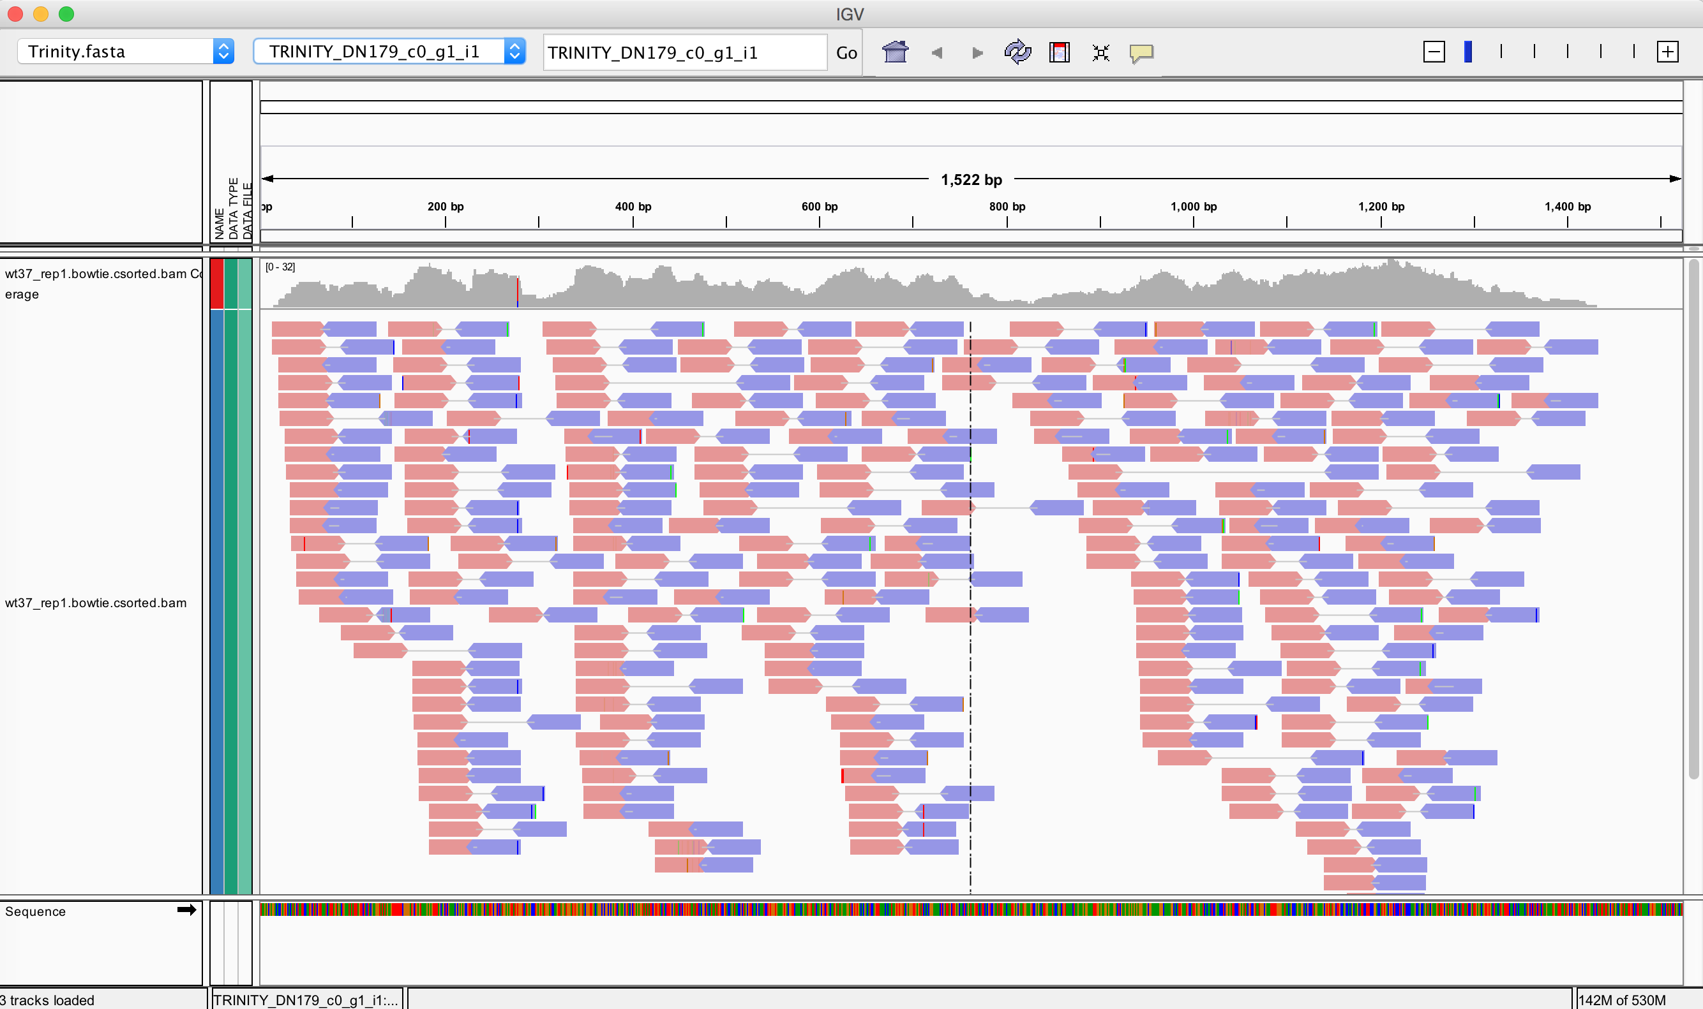
Digital Normalization

Slide 72
Digital Normalization

Slide 73
Digital Normalization Software
khmer’s ‘normalize_by_median.pl’
BBNorm
Trinity’s in silico normalization

Slide 74
Read Partitioning
Divides reads into smaller, closely related datasets – divide and conquer
Significantly reduces computational footprint
Only useful for extremely complex or large samples
Is not aimed to improve assemblies, only to improve efficiency

Slide 75
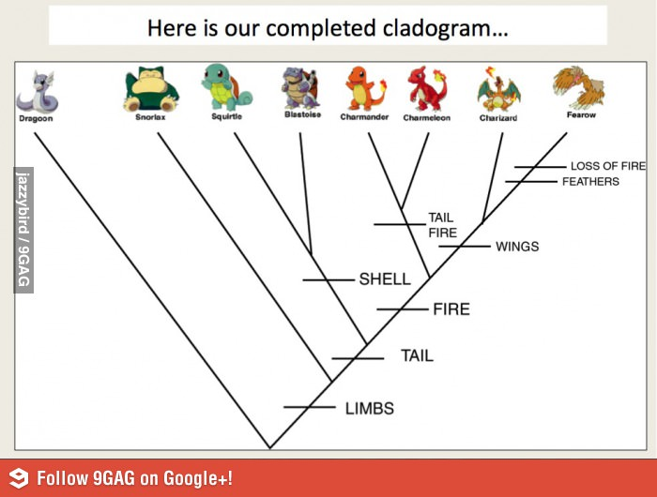
Notes:
Imagine trying to sequence all of these organisms together – very difficutl

Slide 76
Notes:
Read partitioning quarantines each group of similar organisms so that you can run individual assemblies on them.

Slide 77
MetAMOS
Executes a standard assembly pipeline
Can run a plethora of assemblers and annotation software

Slide 79
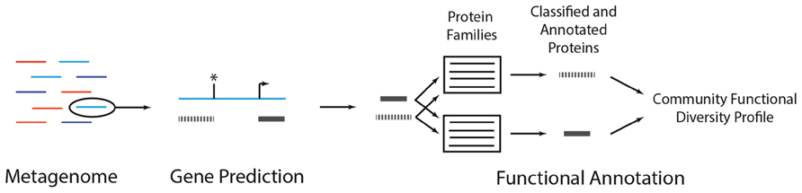
Functional Annotation
Usually done with contigs. Can be done with reads.
T. Sharpton Frontiers in Plant Science 2014

Slide 80
What is Annotation?
Identifying ORFs and assign function to assembled sequences
Most software only require your assembled data and will return your annotated sequences.

Slide 81
Annotation Tools
MG-RAST
DAVID
MEGAN5
Blast2GO
Patric

Slide 82
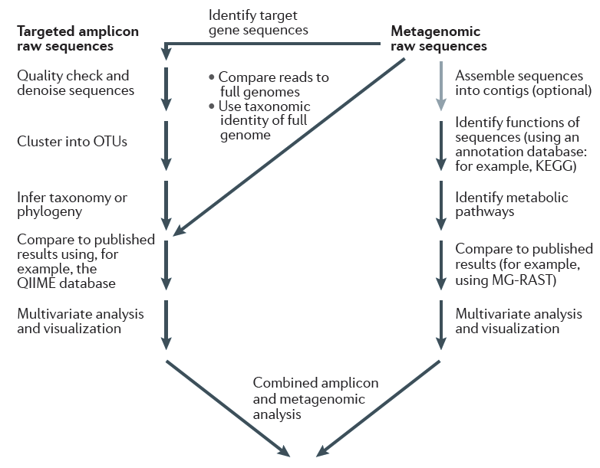
Can do all from one sample
Separate bacteria, virus, RNA, DNA
Kuczynski et al. 2011 Nat Rev Gent 13:47-58

Slide 83
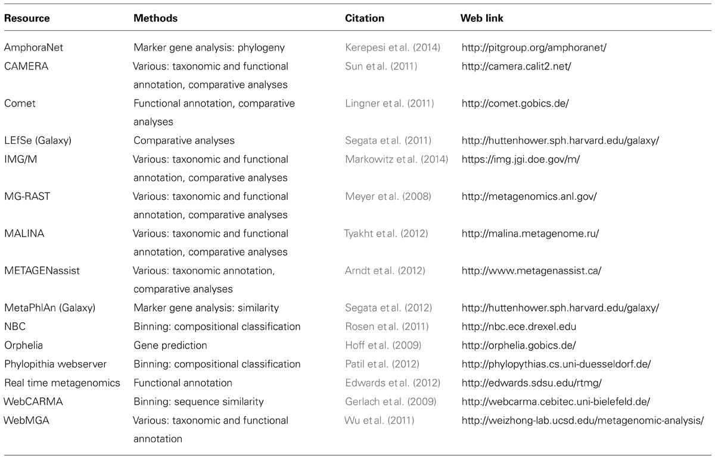
Metagenomics Resources
T. Sharpton Frontiers in Plant Science 2014

Slide 84
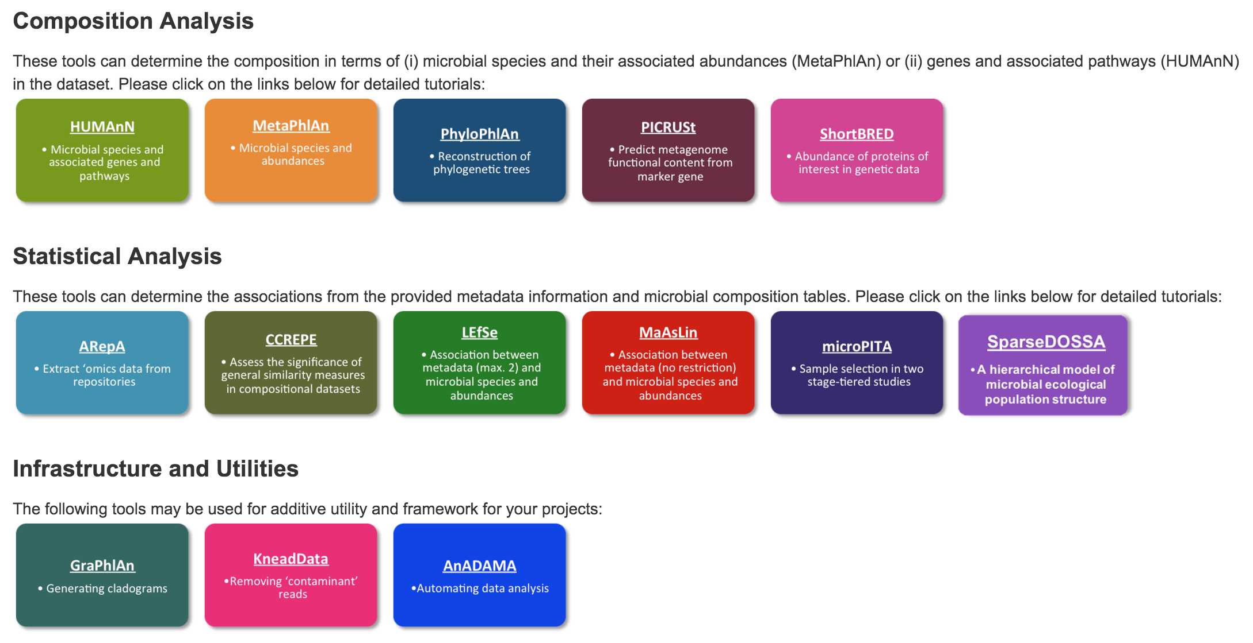
BioBakery (Huttenhower Lab)

Slide 85
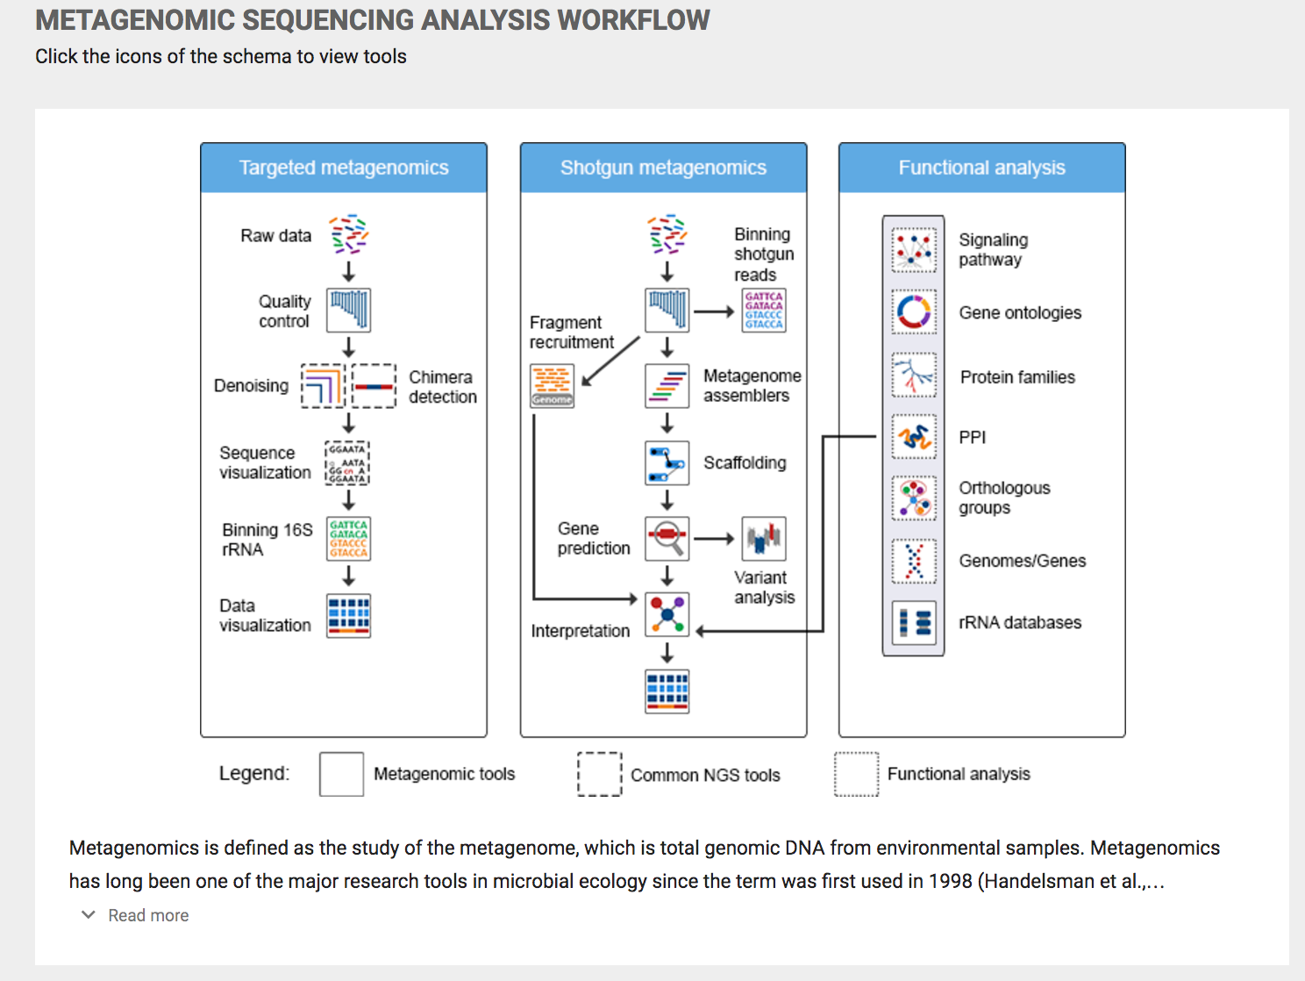
Notes:
Omics tools provides a really nice feature – each icon is clickable and will take you to a list of those tools

Slide 86
MultiQC
MultiQC searches a given directory for analysis logs and compiles a HTML report.
Notes:
MultiQC traverses a directory tree for certain specified output files and will compile them into an interactive HTML report.

